Slide 1
Be + Adjectives Yes/No questions
Basic 1 – Unit 2 Lesson B

Slide 2
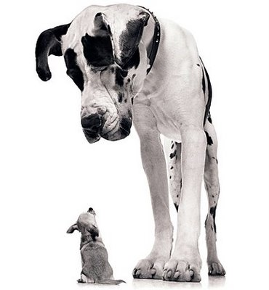
Fido is big.
Fido is big.
Fido is big.
Munchkin is small.
Munchkin is small.
Munchkin is small.

Slide 3
Is Fido big?
Yes, it is.
Is Munchkin big?
No, it isn’t. It is small

Slide 4
Subject + Be + Adjective
The dog is big.
Be + Subject + Adjective
Is the dog big?
Yes, it is.
Be + Subject + Adjective
Is the dog small?
Yes, it is.

Slide 5
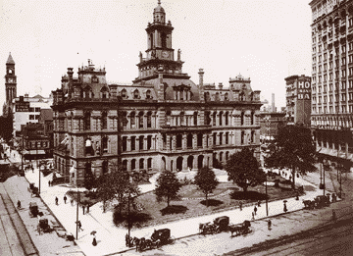
Is the building modern?
No, it isn´t. it is old.

Slide 6
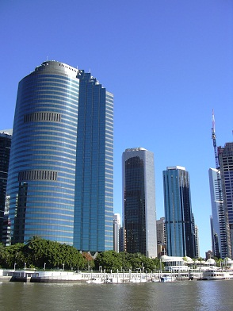
Are the buildings old?
Is the building old?
Yes, it is.
No, they aren´t. They are modern.

Slide 7
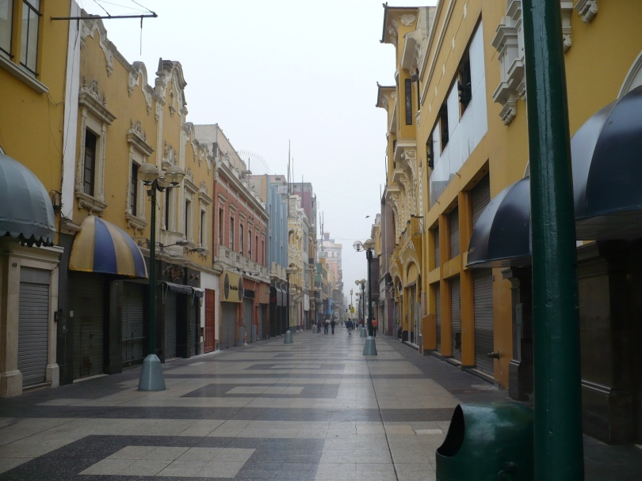
Is the street dirty?
No, it isn´t. It is clean

Slide 8
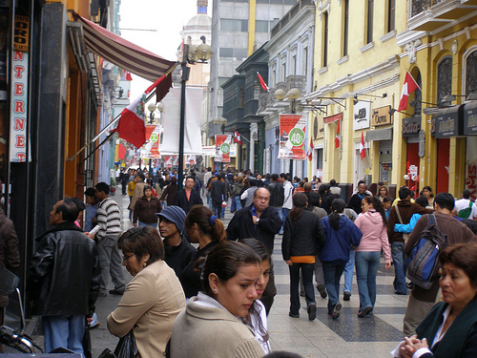
Is the street crowded?
Yes, it is. It is crowded and noisy

Slide 9
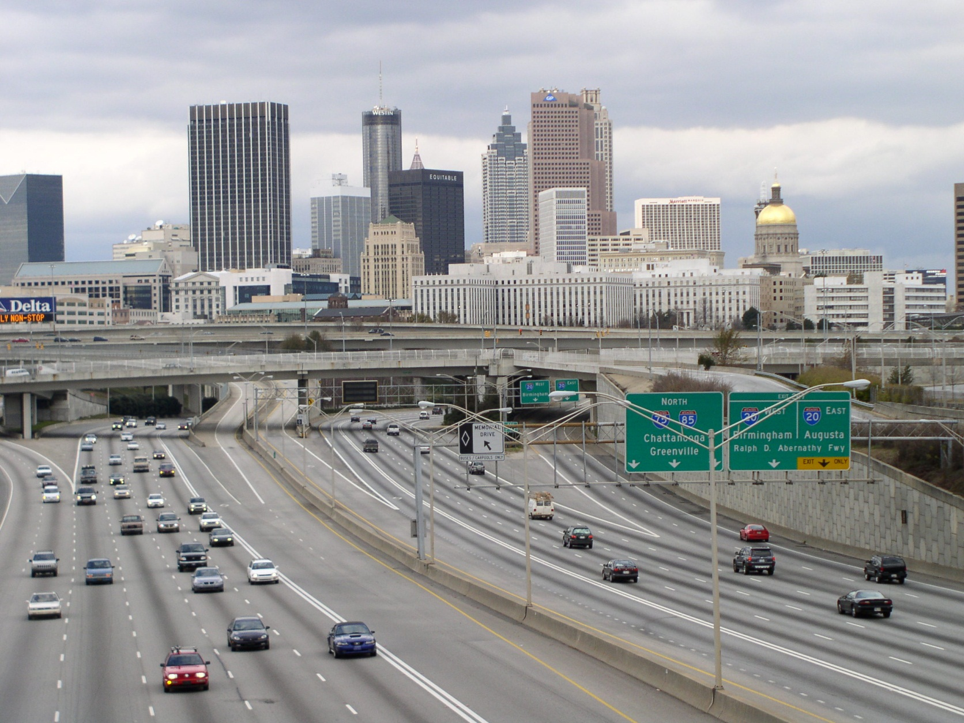
Ask your partner about Atlanta.

Slide 10
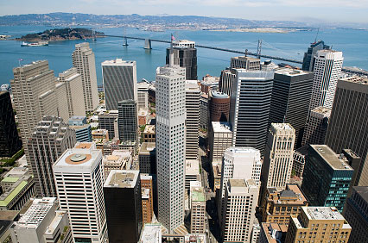
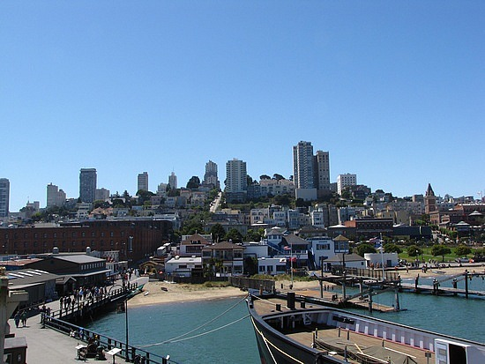
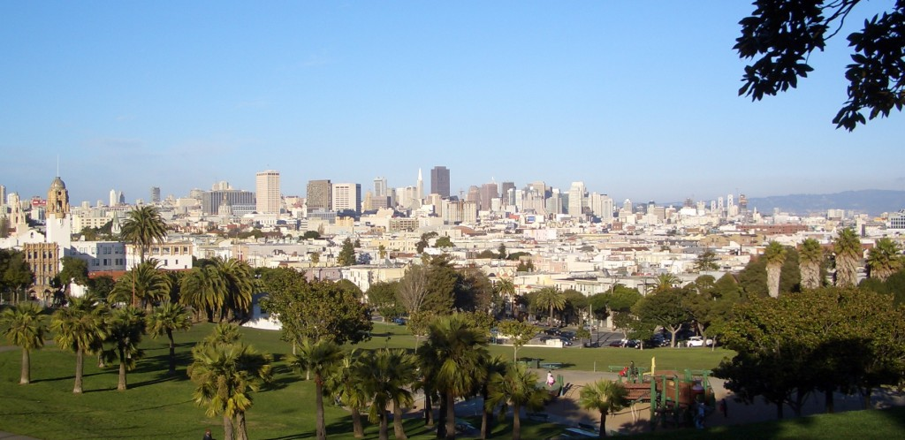
Ask your partner about San Francisco.

Slide 11
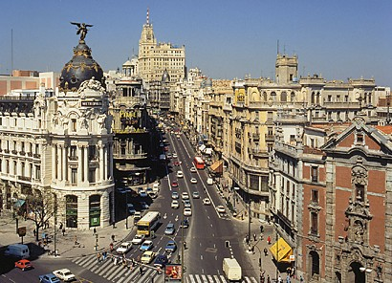
Ask your partner about Madrid.

Slide 12
CAPITALIZATION
CHECKING CAPITAL LETTER

Slide 13
Correct the mistakes
my name is juan
he is a doctor.
he is jorge and i am jose.
Lima is the capital of peru.
PERU IS INTERESTING.

Slide 14
Correct the mistakes
Dear clara,
Hi! My name is eun mi. i´m a student. i´m from seoul, korea. seoul is very big! Ten million people live here. On this postcard is a famous neighborhood: insadong. This neighborhood is interesting. There are art galeries and teahouses. What is your city like?
Write back soon !
eun mi

Slide 15
Writing a postcard

Slide 16
Peru | Lima | Surco
Peru-big | Lima-interesting | Surco-big
People-nice | Lima-noisy and dangerous | Surco-beautiful
Macchu Picchu-old and historic | The restaurants-good | The parks-clean
 | Pacifico university-expensive | The stores-fun
 | Streets-noisy

Slide 17
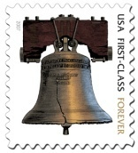
Dear ______________________ __________________________________________ __________________________________________ __________________________________________ __________________________________________ __________________________________________ __________________________________________ __________________________________________ __________________________________________ ____________________ (Your Name) | To : Lala Lyla 333 Three Tree Street San Francisco 94102
Lala
My name is Jose. I am from Lima, Peru. I live in Lima now. Lima is …… The people from Peru are……
………………………………………………………………………… . My house is in Surco. Surco ……………………………………………… ……………………………………………………………………………………………………………………………………………………………………………………………………………………………………………………………………………………
Write back soon
Jose Antonio

Slide 18
vacation

Slide 19
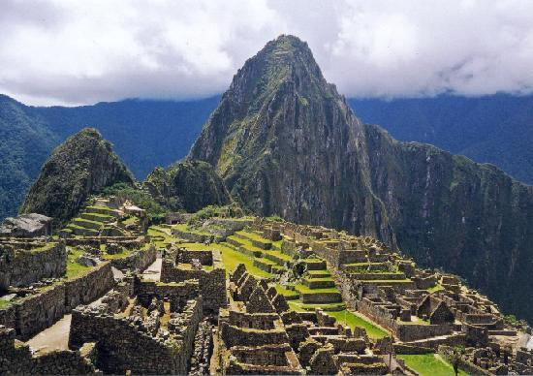
What´s its name?

Slide 20
Where is Machu Picchu?

Slide 21
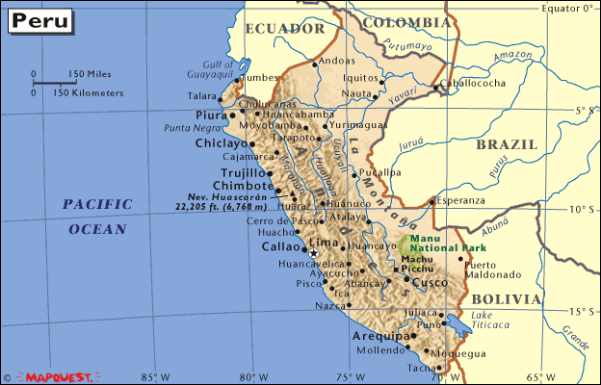
It´s in Peru.

Slide 22
What is Machu Picchu like?

Slide 23
Is Machu Picchu a good place for vacation?

Slide 24
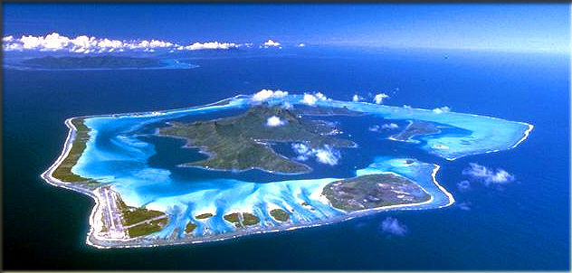
It´s an island

Slide 25
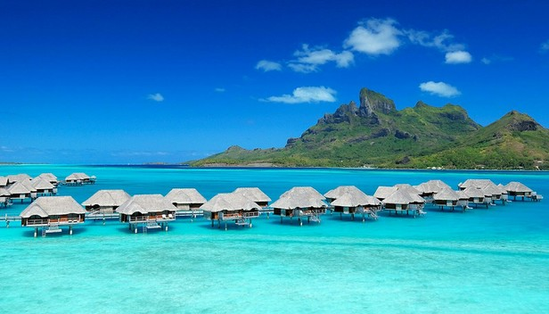
Its name is Bora Bora.

Slide 26
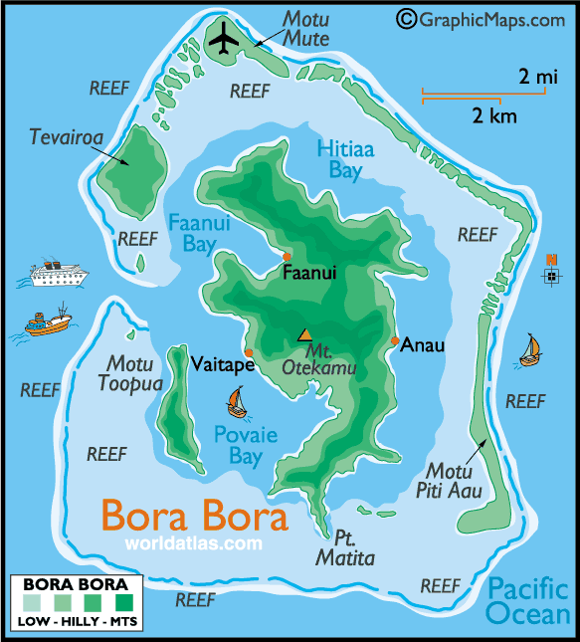
Where is Bora Bora?

Slide 27
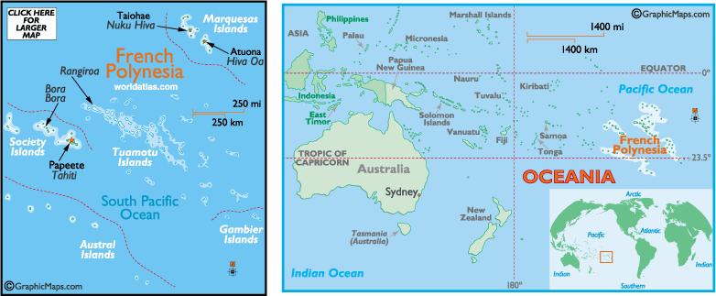
It´s in French Polynesia.

Slide 28
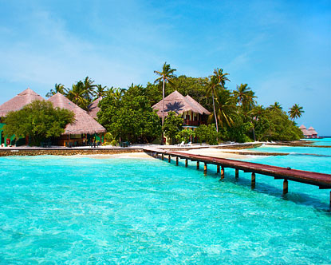
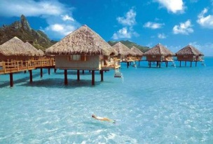
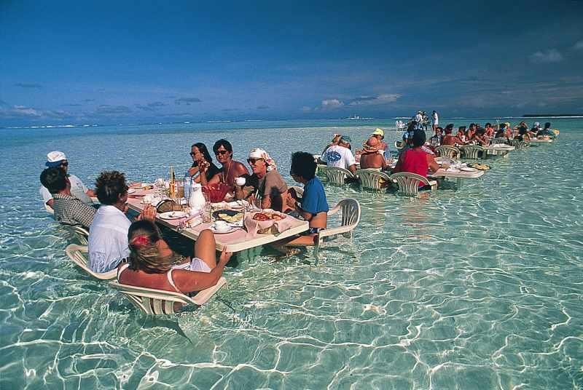
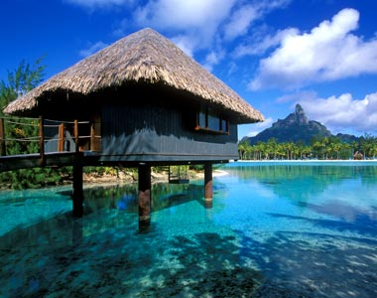
What is it like?

Slide 29
Is Bora Bora a good place for vacation?

